Slide 1
ECLI IN ROMANIA
BO-ECLI Conference
Athens, 08 - 09/06/2017
Razvan CRACIUNESCU
IT Manager
Ministry of Justice - ROMANIA

Slide 2
Romanian Court System
1) The High Court of Cassation and Justice/ the Supreme Court - 1;
2) Courts of appeal - 15;
3) Tribunals/ intermediate level courts – 46:
42 regular tribunals;
3 special tribunals, i.e. for commercial matters;
1 tribunal for Minors and Family Matters;
4) Courts of first instance (district courts) - 175.
The Constitutional Court is responsible for reviewing judicial issues pertaining to the provisions of the Romanian Constitution; it is not considered as being a part of the court system.
Notes:
The hierarchy of the Romanian court system is established on 4 levels, as shown in the slide.
There are approximately 2 million cases tried per year in Romania.

Slide 3
RO Judiciary IT System

Slide 4
ECLI in Court Decisions
Scan from a court decision

Slide 5
ECLI Syntax in RO
ECLI has been assigned to all court decisions available in ECRIS CDMS Courts, as follows:
Metadata, for decisions 2007-2015;
Metadata and in the decision content, for decisions 2016-present
ECLI:RO:JDS4B:2017:001.004053
Court ECLI Code
Document ID in the corresponding Court’s Decisions Register
(unique at registry level)
Year of Decision
Court’s Decisions Register ID (internal, unique at court level)

Slide 6
ECLI as seen by judges and clerks
Capture from the ECRIS CDMS module, the RO Courts’ Case Document
Management System
This is where the ECLI is generated

Slide 7
ECLI as seen in ROLII website
Capture from ROLII Website
(jurisprudence)

Slide 8
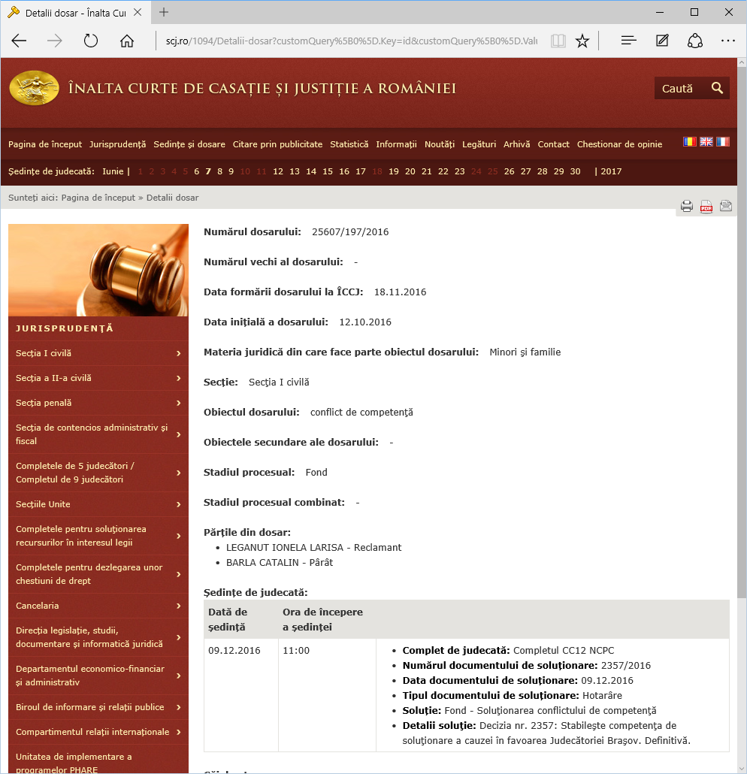
ECLI for public – not there yet
RO Courts’ Portal
HCCJ Website
ECLI to be added here

Slide 9
Institutional/ legal framework on publication in RO
Romanian Ministry of Justice (MoJ) is the designated national ECLI coordinator (according to Government Decision no. 328/27.04.2016);
Superior Council of Magistracy (SCM), authority having administrative, normative and jurisdictional competences regarding the efficient organization and functioning of the courts, is responsible for ensuring the publication of court decisions;
‘Romanian Legal Information Institute’ Foundation (ROLII) – entity co-funded by SCM for the specific purpose of developing the appropriate infrastructure for publishing court decisions on the internet, so as to ensure free and unrestricted access to case law for all interested persons;
No legal framework has been adopted on the publication of court decisions – there is however an extensive policy framework.

Slide 10
Public access to court decisions in RO
All decisions of the Romanian courts (Supreme Court, courts of appeal, tribunals, courts of first instance) rendered since 2010 have been published in the ROLII case law web portal (http://www.rolii.ro/), officially launched in December 2015;
Relevant courts’ decisions (i.e. those judgments that bring something new or significant to the interpretation of the Romanian law) for all Romanian courts (except for those of the Supreme Court) are available as well on a separate website (http://portal.just.ro/SitePages/jurisprudenta.aspx) - the Supreme Court publishes its most important judgments on its own website (http://www.scj.ro/1258/Jurisprudenta);
ECLI code and metadata is assigned to the published case law - as the ECLI code is automatically assigned through the ECRIS system, it will be used on all rendered judgments (not only on published judgements).

Slide 11
Next steps – RO MoJ proposals
Updating the MoJ web portal for the courts (http://portal.just.ro) and HCCJ website so as to publish the relevant case law together with the assigned ECLI code;
Improving the integration of ECRIS CDMS Courts with the ROLII case-law web portal in order to automatically export the ECLI code as metadata; implementing case law search options by ECLI identifier and metadata;
Analizing the options for: supplying information about the final decision rendered (i.e. following appeal/ second appeal); tagging the important decisions either manually or in an automated manner; publishing the anonymization rules and rectifying anonymisation errors; translating in full or summaries of decisions that are relevant for the legal community abroad;
Connecting the ROLII case law web portal to the European e-Justice portal;
By 2024 MoJ aims at updating and integrating into a single system every application that is currently being managed by various judicial entities.

Slide 12
Thank you!
Razvan Craciunescu
razvan.craciunescu@just.ro
This project is co-funded by
the European Union
This presentation has been produced with the financial support of the Justice Programme of the European Union. The contents of this publication are the sole responsibility of the partners of the BO-ECLI project and can in no way be taken to reflect the views of the European Commission.

